Slide 1
Bellabeat,
Smart Device analysis
Presented by: Dylan Walsh
Last Updated: 10/27/2022

Slide 2
Tables of Contents
Objective
Daily Activity of Users
Sleep Analysis
Calories Burned
Conclusions
Suggestions

Slide 3
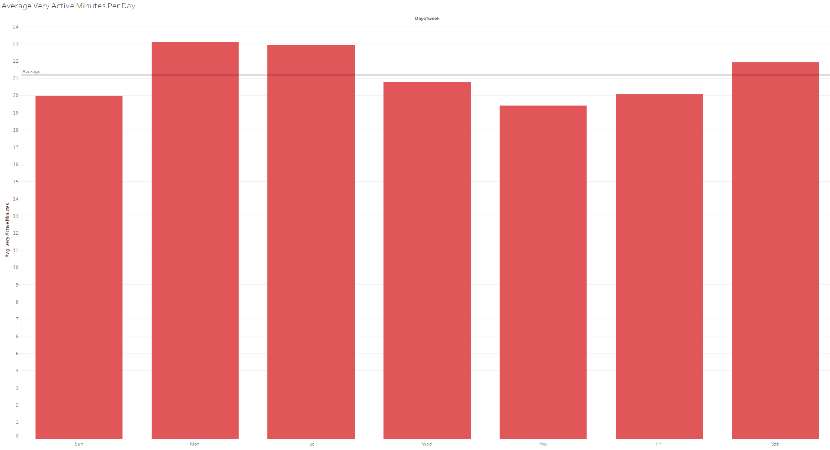
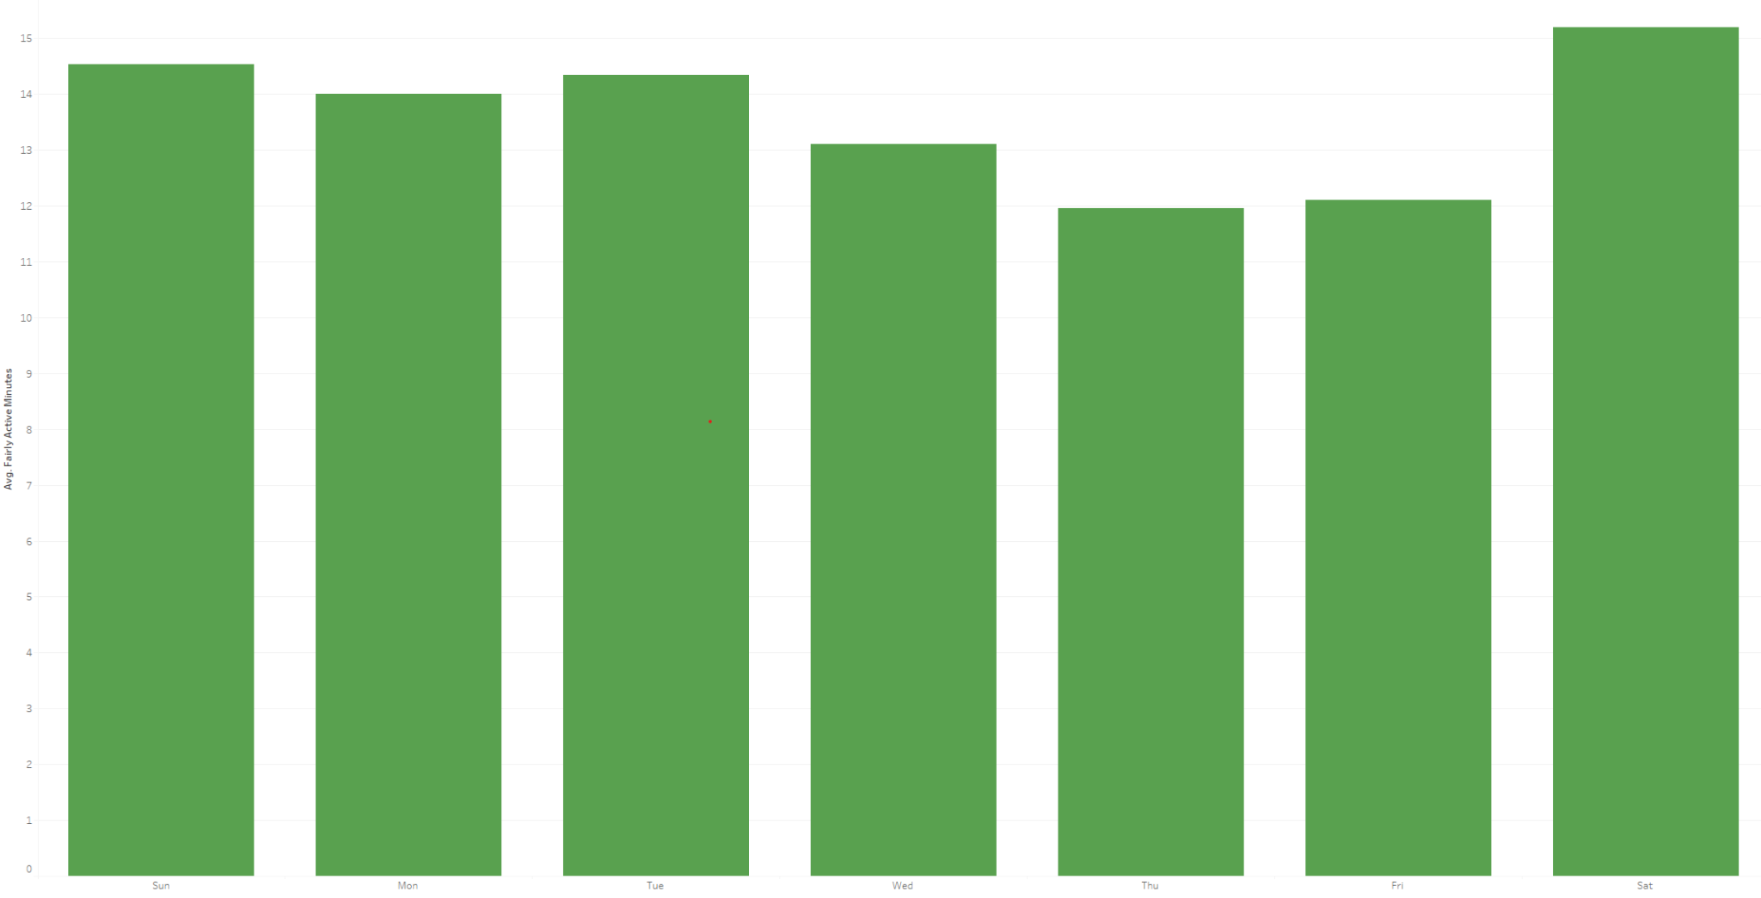
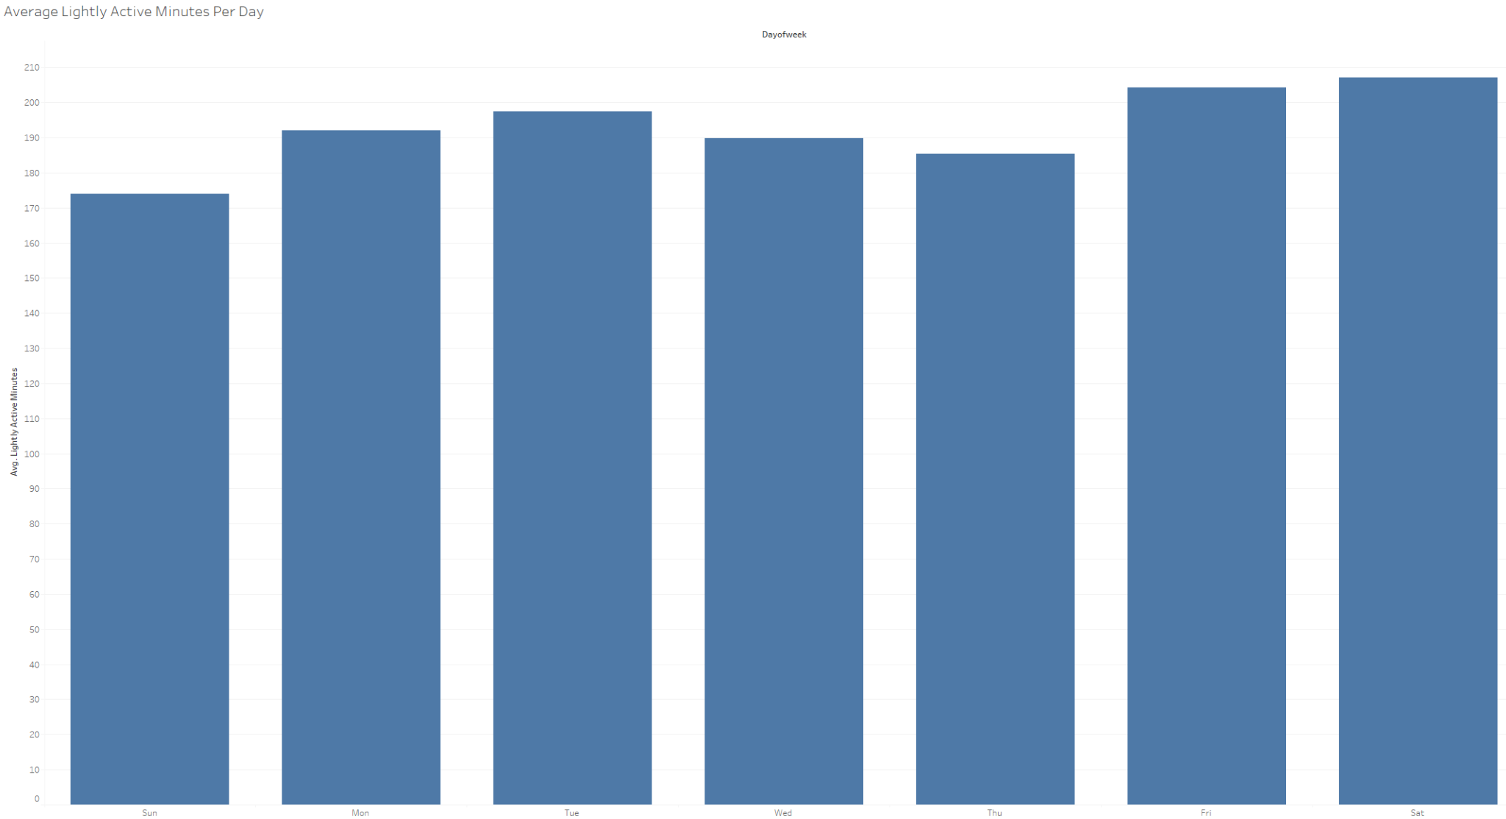
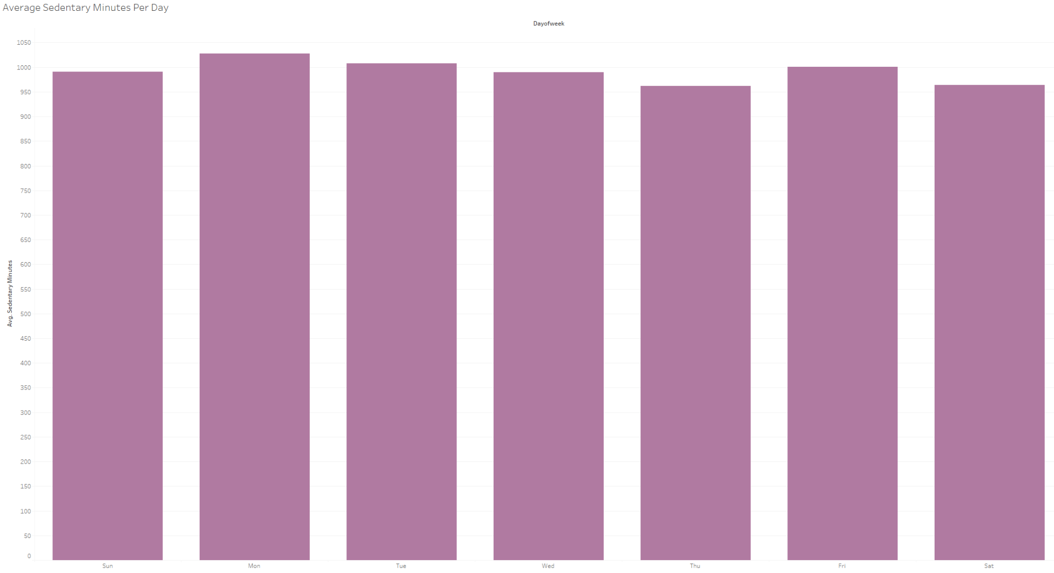
Activity Minutes per Activity
Very Active
Fairly Active
Lightly Active
Sedentary

Slide 4
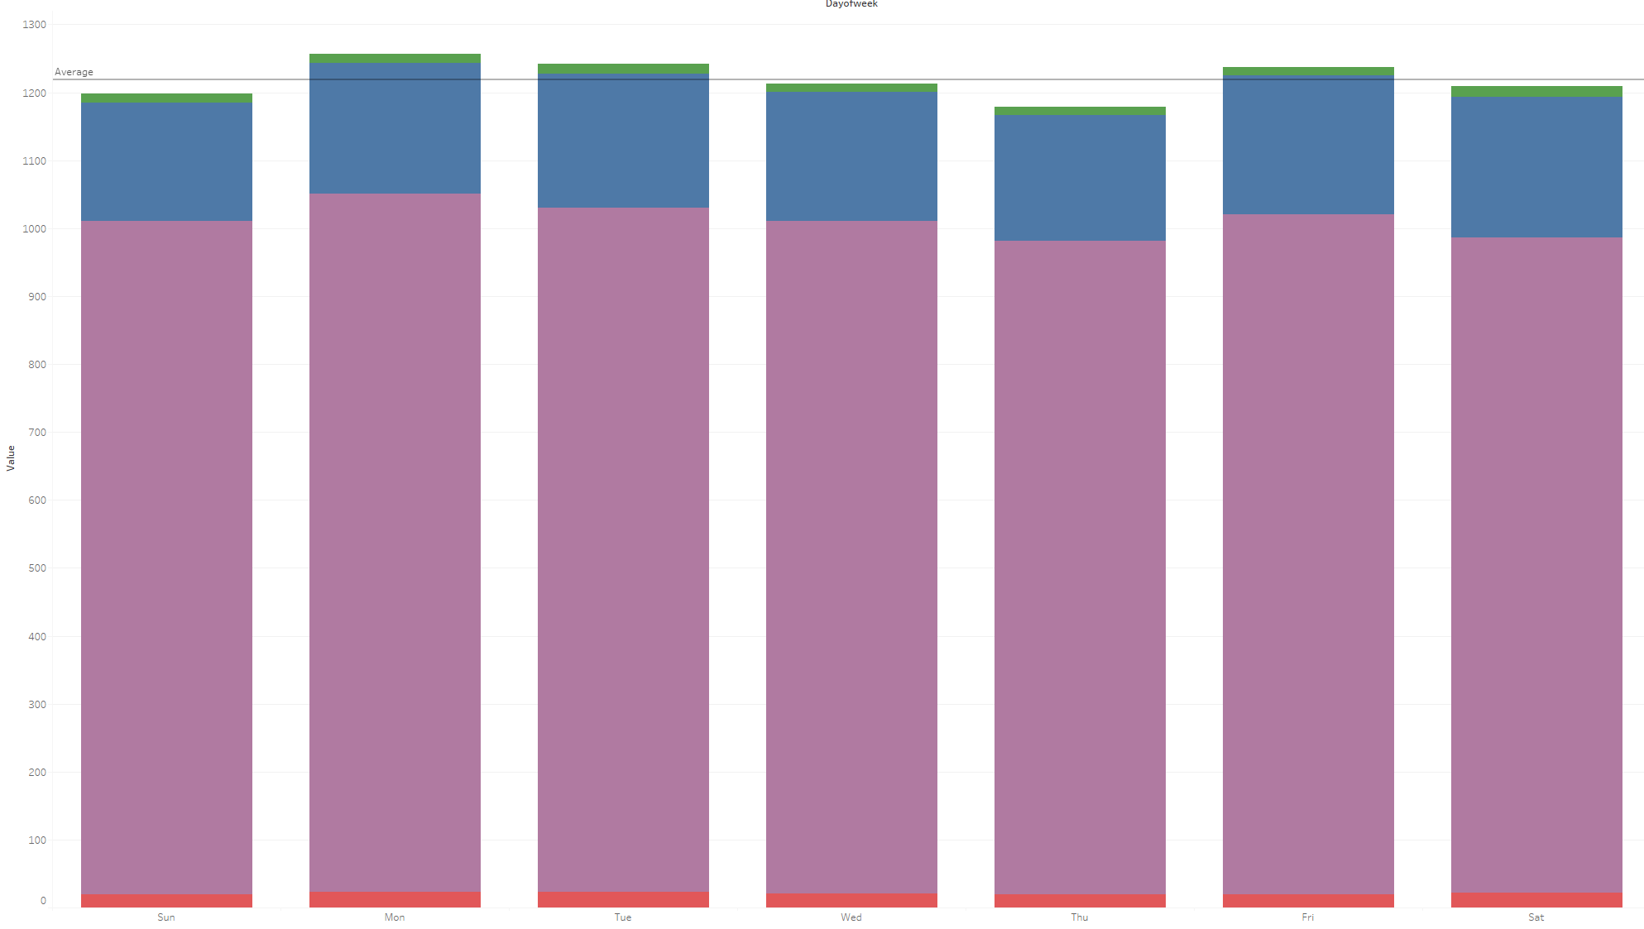
Weekly Activity Minutes
Very Active
Fairly Active
Lightly Active
Sedentary

Slide 5
On average users spend more time performing light activity and sedentary activity.

Slide 6
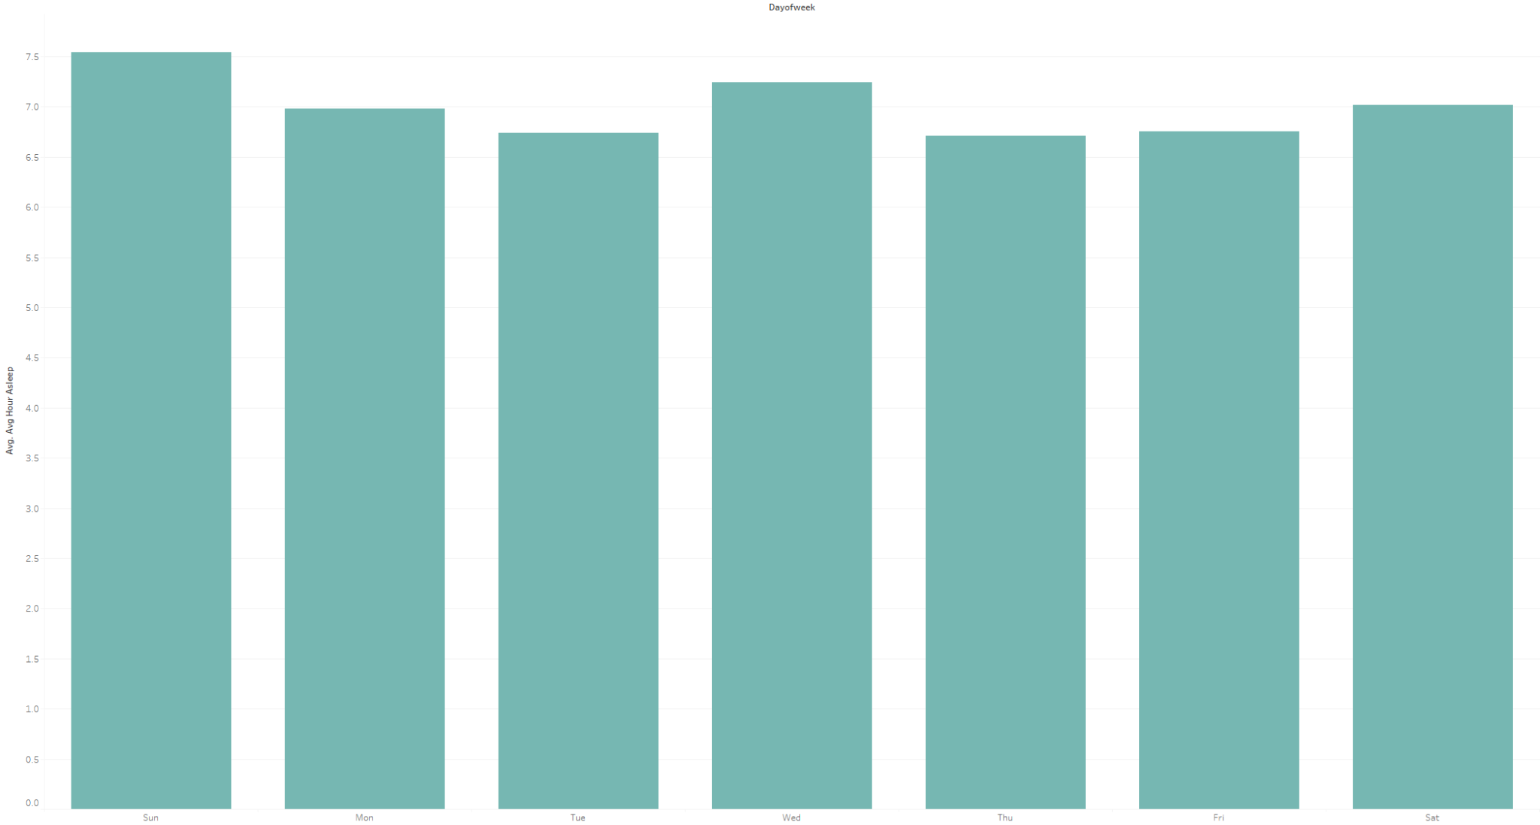
Average Hours Asleep
Sunday has the highest average amount of sleep.
Whereas Tuesday and Thursday has the lowest.
On Average users are receiving about 7 hours a sleep per day.

Slide 7
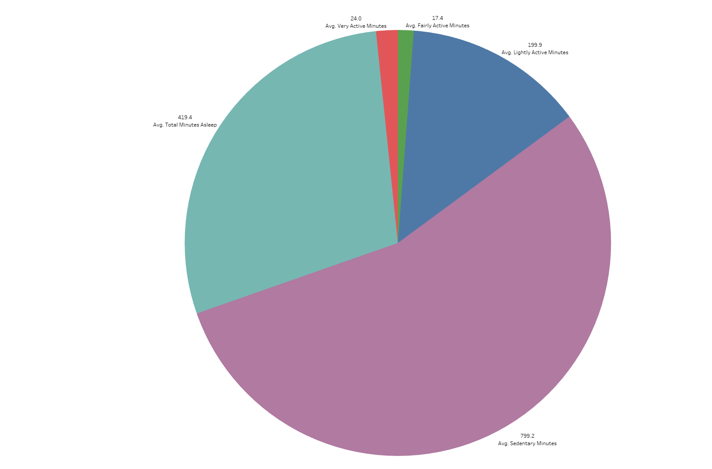
Time Spent Sleeping vs Activities

Slide 8
Users tend to spend on average the most time sleeping or in sedentary activities. Users also get more sleep on weekends.

Slide 9
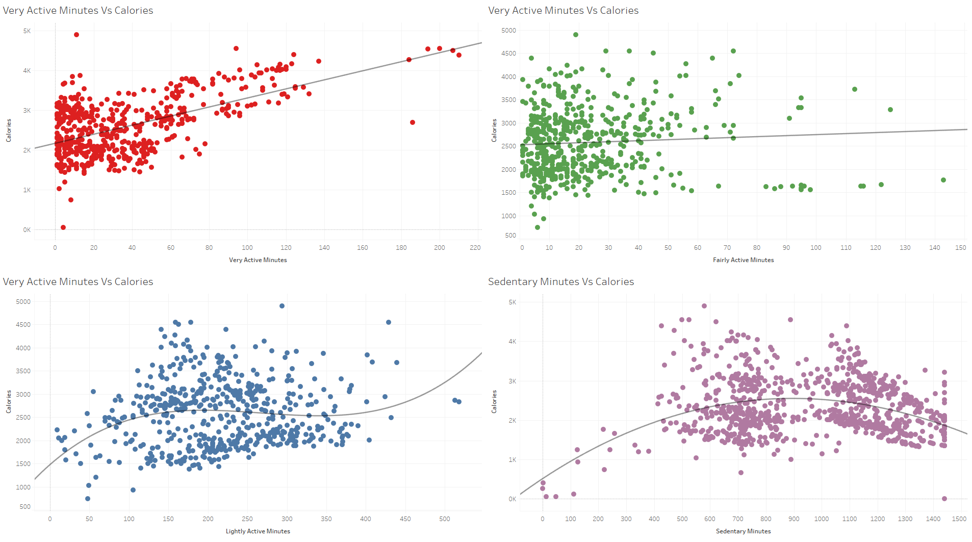
Calories Burned

Slide 10
Calories Burned
Very, Fairly, and Lightly active shows some upward trend.
Sedentary minutes however, shows an upward trend followed by a downward trend
Each chart is statistically significant however, the linear relationship is weak.

Slide 11
Calories burned vs minutes spent on activity has a weak linear relationship.

Slide 12
Conclusions
Users on average spend more time performing Light or Sedentary Activity.
Users on average sleep longer on the weekend and less on the weekdays.
Calories Burned do not have a linear relation with active minutes.

Slide 13
Suggestions
Most users are not heavy active users. With this Bellabeat can focus their efforts into a healthy but stylized products.
Bellabeat could partner with other fitness brands. Allowing coupons or discounts to be attained through the Bellabeat products when milestones are achieved.
Notifications and more alertness with the Bellabeat app. Possibility of combining this with the coaching service to indicate to users when activity is needed for the day.

Slide 14
Questions?

